Slide 1
dEX team survey

Slide 2
Summary of Data
Average Happiness is 6.4/10
Question with lowest score is
“Do you and your colleagues OUTSIDE of dEX team work to achieve the same goals? “
Question with highest score is
“Are you fully empowered and accountable for the work that you do?“

Slide 3
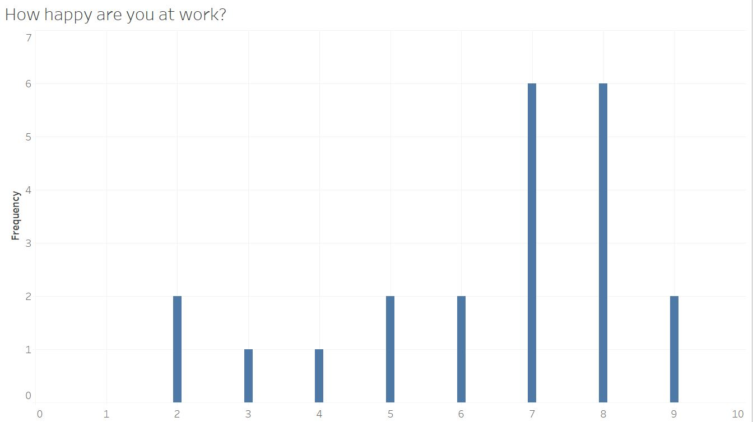
How happy are you at work?
Unhappy
Neutral
Happy

Slide 4
What factor affect team member satisfaction?

Slide 5
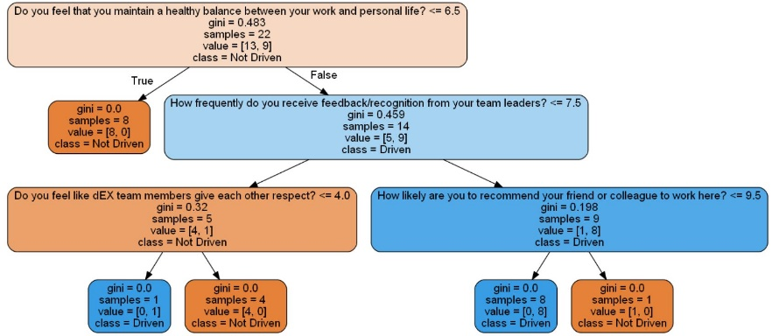
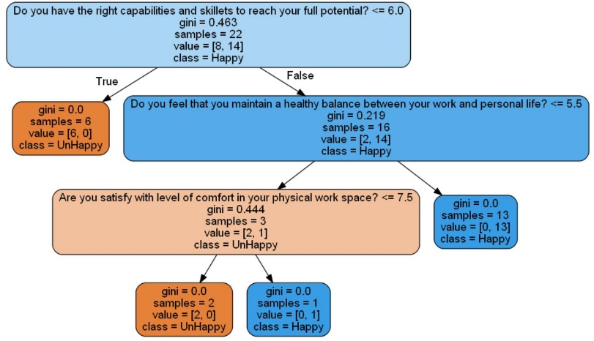
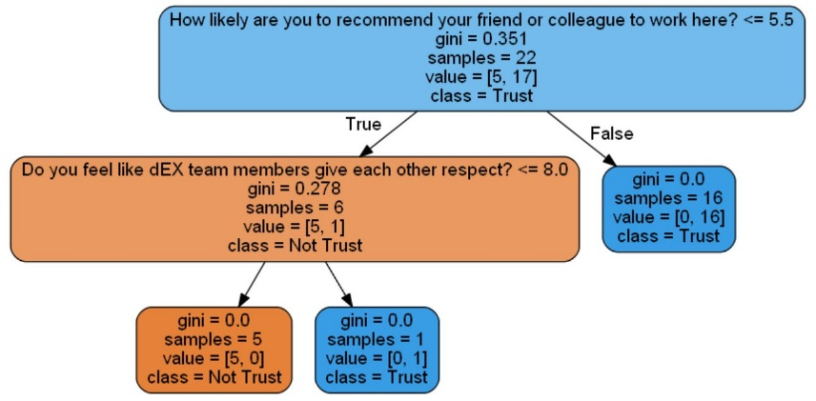
How ?
I use machine learning to find the most important factor that dictate team member satisfaction. We use three different y (prediction attribute) in this example.
1. y = Happiness
2. y = Driven value for GC
3. y = Trust team leader

Slide 6
Most concerning factor
1. Capabilities and skillets to reach full potential
2. Healthy work life balance
3. Feedback and recognition from your team leader
4. Trust and Respect within the team

Slide 7
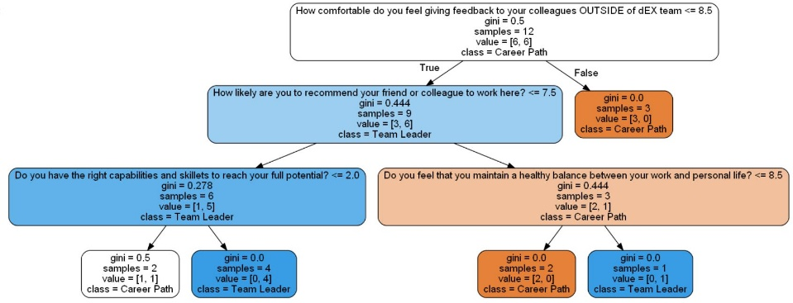
What affect team member satisfaction?
I use machine learning to find the most important factor that dictate team member satisfaction. We use three different y (prediction attribute) in this example.
1. y = Happiness
2. y = Driven value for GC
3. y = Reason to Quit
Most concerning factor
1. Capabilities and skillets to reach full potential
2. Healthy work life balance
3. Feedback and recognition from your team leader
4. Trust and Respect within the team

